Slide 1
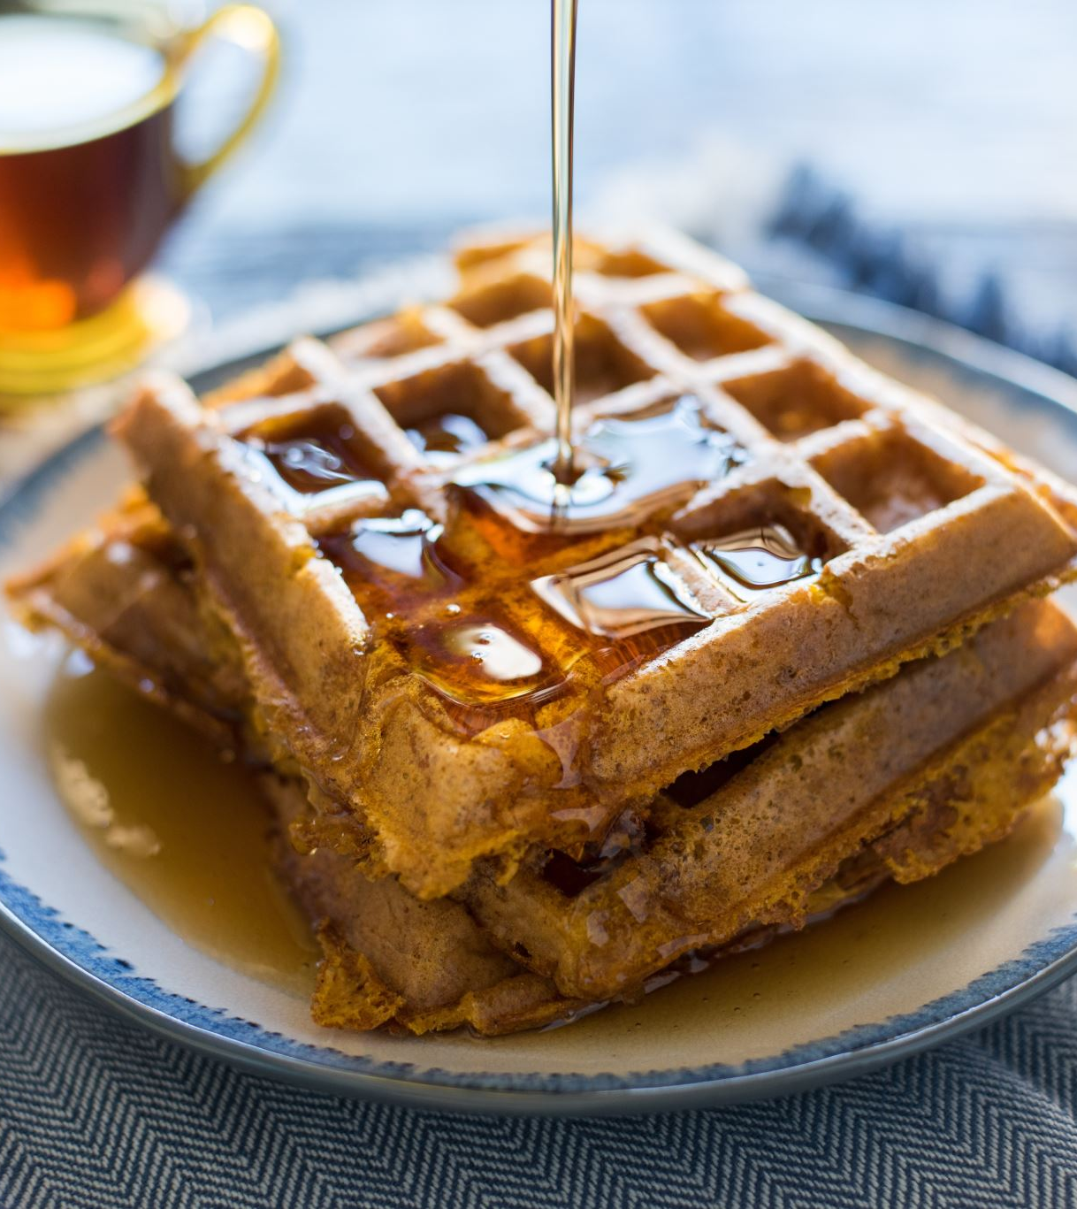
DATA 606 CAPSTONE PROJECT SENTIMENT ANALYSIS ON YELP DATASET REVIEWS
ARJUN REDDY SEELAM
Spring 2021

Slide 2
Introduction
In today's world as everything is being accessible at the fingertips, people want to know which restaurant is good or which restaurant is bad, online reviews has a huge impact on restaurants as the reviews can make the customers choose the restaurant or go for another one based on reviews.
Basically, online reviews can make the business upside down based on positivity. So, feedbacks can help the restaurants to overcome any changes to be made and improve the quality of the food.

Slide 3
Dataset
Opensource dataset downloaded from: https://www.yelp.com/dataset which is available publicly.
Dataset is of Json format and has 1 million 48 thousand 576 records.
Considering only 30,000 records for modeling.
Attributes: Review Id, User Id, Business Id, Star rating, Funny, Cool, Text, Timestamp.

Slide 4
Project AIM
Usually, all the reviews in the Yelp data has the star ratings from 1 to 5 (1 being the lowest and 5 being the highest). So, converting these numeric ratings into sentiment (>3 : good, 3 : neutral, <3 : bad) by model development, which will help us to understand the sentiment of reviews.
Analyzing the trend by identifying the restaurants which has gained positiveness among the reviews over the time in a particular area.
The conclusion obtained from the trend analysis of the model helps the restaurants to gain insights on the how the business is going on and make changes if necessary.
Research Question:
Is there any difference in improvement of ratings for a restaurant over the time based on negative review trend?
Did the restaurants really take the reviews into consideration to make changes in the business?

Slide 5
References
H. S. and R. Ramathmika, "Sentiment Analysis of Yelp Reviews by Machine Learning," 2019 International Conference on Intelligent Computing and Control Systems (ICCS), Madurai, India, 2019, pp. 700-704, doi: 10.1109/ICCS45141.2019.9065812.
How to Perform Sentiment Analysis on Yelp Restaurant Reviews. (2020, October 14). MonkeyLearn Blog. https://monkeylearn.com/blog/yelp-sentiment-analysis/

Slide 6
Thank You !!!

